Slide 1
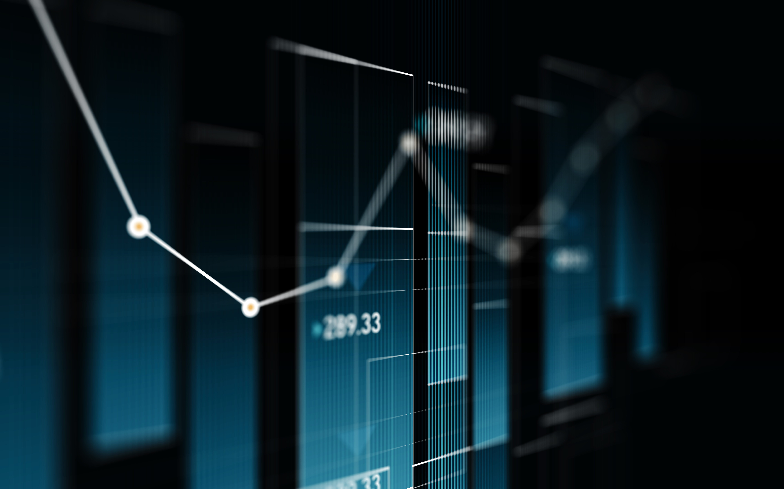
Introduction Python (Class – 01)
HASAN MAHMUD RHIDOY
Software Development Engineer, BRAC IT

Slide 2
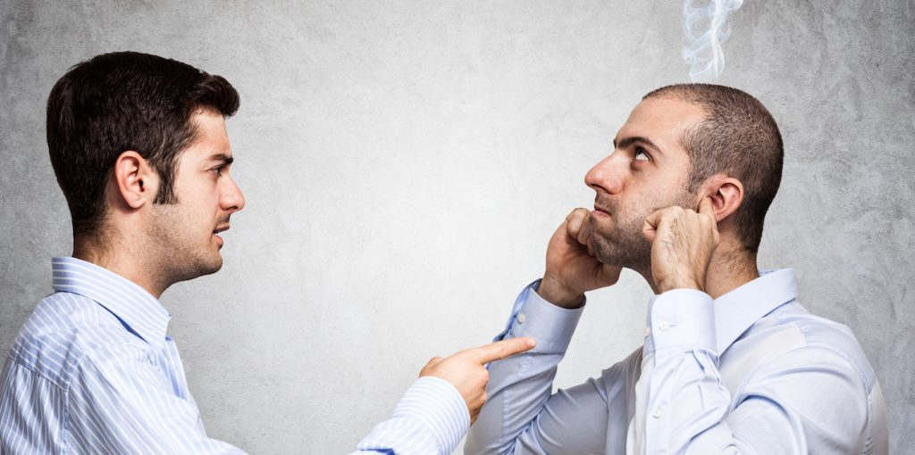
What is Language?
Language is a mode of communication that is used to share ideas, opinions with each other.

Slide 3
What is Programming Language?
A programming language is a computer language that is used by programmers (developers) to communicate with computers.
A programming language is mainly used to develop desktop applications, websites, and mobile applications.
Types Of Programming Language
Low-level programming language is machine-dependent (0s and 1s) programming language. Example – Assembly Language.
High-level programming language is designed for developing user-friendly software programs and websites. The main advantage of a high-level language is that it is easy to read, write, and maintain. Example - Python, Java, JavaScript, PHP, etc.
Middle-level programming language lies between the low-level programming language and high-level programming language. A middle-level programming language's advantages are that it supports the features of high-level programming, it is a user-friendly language, and closely related to machine language and human language. Example: C, C++

Slide 4
What is Python?
Python is a general purpose, dynamic, high-level, and interpreted programming language.
It supports Object Oriented programming approach to develop applications.
Python's syntax and dynamic typing.
Python supports multiple programming pattern, including object-oriented, imperative, and functional or procedural programming styles.
We don't need to use data types to declare variable because it is dynamically typed so we can write num = 10 to assign an integer value in an integer variable.

Slide 5
Python History and Versions
Python laid its foundation in the late 1980s.
The implementation of Python was started in December 1989 by Guido Van Rossum at CWI in Netherland.
In February 1991, Guido Van Rossum published the code (labeled version 0.9.0) to alt.sources.
In 1994, Python 1.0 was released with new features like lambda, map, filter, and reduce.
Python 2.0 added new features such as list comprehensions, garbage collection systems.
On December 3, 2008, Python 3.0 (also called "Py3K") was released. It was designed to rectify the fundamental flaw of the language.
There is a fact behind choosing the name Python. Guido van Rossum was reading the script of a popular BBC comedy series "Monty Python's Flying Circus". It was late on-air 1970s. Van Rossum wanted to select a name which unique, sort, and little-bit mysterious. So he decided to select naming Python after the "Monty Python's Flying Circus" for their newly created programming language.
Latest version ->
Python 3.10.6 | 2021-10-04

Slide 6
Compiled vs. Interpreted Languages
Compiled language: Entire program is translated to machine code at once, then the machine code is run by the CPU.
Interpreted language: Program is read line-by-line and as soon as a line is read the machine instructions for that line are executed by the CPU.

Slide 7
Why learn Python?
Python provides many useful features to the programmer. These features make it most popular and widely used language.
Easy to use and Learn
Object-Oriented Language
Dynamic Memory Allocation
Wide Range of Libraries and Frameworks
Open Source Language
Interpreted Language

Slide 8
Where is Python Used?
Python is a general-purpose, popular programming language and it is used in almost every technical field.
Data Science
Software Development
Machine Learning
Artificial Intelligence
Ethical Hacking, and so on.

Slide 9
Python Popular frameworks and Libraries
Python has wide range of libraries and frameworks widely used in various fields such as machine learning, artificial intelligence, web applications, etc.
Web development (Server-side) - Django Flask, Pyramid, CherryPy
Machine Learning - TensorFlow, PyTorch, Scikit-learn, Matplotlib, Scipy, etc.
Mathematics - Numpy, Pandas, etc.

Slide 10
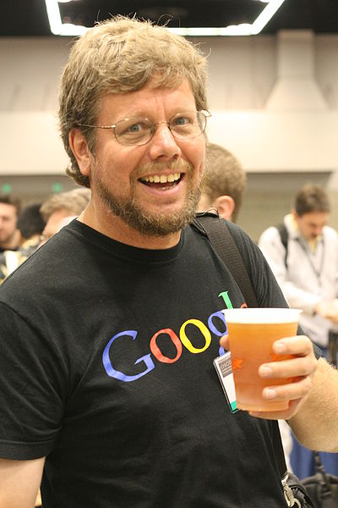
“Python is an experiment in how much freedom programmers need. Too much freedom and nobody can read another's code; too little and expressiveness is endangered.”
- Guido van Rossum

Slide 11
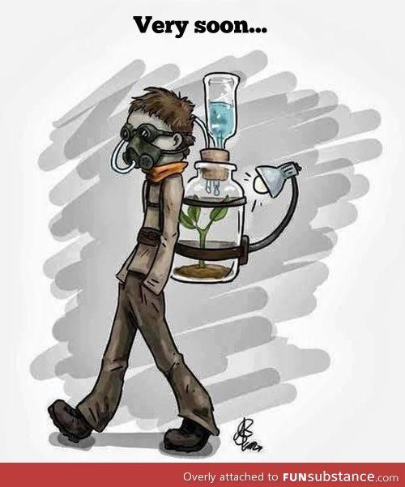
Environment Setup

Slide 12
IDE ?
IDE is an acronym for “Integrated Development Environment”, and it is nothing more than an application that can be used to develop any kind of software programs.
5 reasons why you need an IDE (and how it can save you so much time)
Syntax highlighting
Text auto-completion
Refactoring options
Importing libraries
Build, compile, or run

Slide 13
